Slide 1

Four Probe Setup
DEPARTMENT OF BASIC SCIENCES
(APPLIED SCIENCE)
Presenters :
BT23CSE013-Yogesh
BT23CSE014-Adithya Kurani
BT23CSE015-Praneeth
BT23CSE016-Dhruva Narayan
Mentored By - Dr. Aatish S Daryapurkar
4 POBE SETUP

Slide 2
FOUR PROBE SETUP
02
PLAN OF TALK
HISTORY
BAND THEORY
TWO PROBE SETUP
FOUR PROBE SETUP
AIM
APPARATUS
FORMULA USED
PROCEDURE
OBSERVATIONS
RESULT
THEORY
EXPERIMENT
PRECAUTIONS
APPLICATIONS
REFERENCES

Slide 3
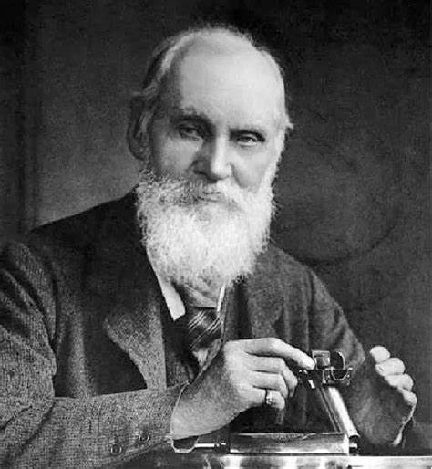
FOUR PROBE EXPERIMENT
03
HISTORY
Four - terminal sensing also known as Kelvin sensing , after William Thomson, Lord Kelvin, who invented the Kelvin bridge in 1861 to measure very low resistances using four-terminal sensing

Slide 4
FOUR PROBE EXPERIMENT
04
Theory
Ohm's law: If physical conditions (like temperature, mechanical stress) remains unchanged, then potential difference across two ends of a conductor is proportional to current flowing through it.
𝑉 ∝ 𝐼 𝑉 = 𝐼𝑅
The constant of proportionality, R, is called resistance of the conductor.
Resistivity: At a constant temperature, the resistance, R, of a conductor is (i) proportional to its length and (ii) inversely proportional to its area of cross-section,
R = ρ(L/A)
The constant of proportionality, ρ , is called resistivity of material of the conductor. Resistivity of a material is equal to the resistance offered by a wire of this material of unit length and unit cross-sectional area. Unit of resistance is ohm (Ω), and unit of resistivity is ohm-meter ( Ω-m )

Slide 5
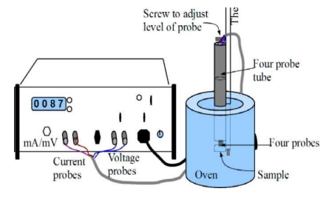
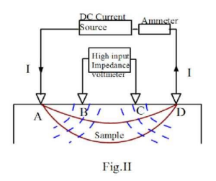
FOUR PROBE EXPERIMENT
05
The 4-point probe set up -
- The four-probe method is used for measuring the resistivity of a sample material.
- The setup consists of four tungsten metal tips with finite radii, evenly spaced.
- Each tip is supported by springs to minimize sample damage during probing.
- The four metal tips are part of an auto-mechanical stage that can move up and down during measurements.
- A high impedance current source is used to supply current through the outer two probes.
- A voltmeter measures the voltage across the inner two probes to determine the sample's resistivity.
- The inner probes do not draw current because of the high input impedance of the voltmeter, eliminating unwanted voltage drops caused by contact resistance between the probes and the sample.
- The contact resistances between probes and the sample are highly sensitive to pressure and surface conditions, such as oxidation.
- Typical probe spacing in this setup is approximately 2 mm.
Notes:
Type of slide: Info-dense

Slide 6

FOUR PROBE EXPERIMENT
06
In order to use this four probe method in germanium crystals or slices it is necessary to assume that:
The resistivity of the material is uniform in the area of measurement
A non conducting boundary is produced when the surface of the crystal is in contact with an insulator.
The derivation of equations given below are involved. For each case it is assumed that the probes are equally spaced (spacing =s).
Case I: Resistivity Measurements on a Large Sample: We assume that the metal tip is infinitesimal and sample are semi infinite in lateral dimensions. For bulk samples where the sample thickness, W >> S , the probe spacing, we assume a spherical protrusion of current emanating from the outer probe tips. The resistivity is computed to be
where V = floating potential difference between the inner probes, unit: volt
𝐼 =current through the outer pair of probes, unit: ampere
s = spacing between point probes, unit: meter
ρ0 = resistivity, unit: ohm meter
Resistivity of Germanium (semiconductor) crystals or slices:

Slide 7



FOUR PROBE EXPERIMENT
07
Case II: Resistivity Measurements on a Thin Slice-Nonconducting Bottom Surface:
For the case of a nonconducting bottom on a slice the resistivity is computed from
S.No. | W/S | G7(W/S)
1. | 0.100 | 13.863
2. | 0.141 | 9.704
3. | 0.200 | 9.631
4. | 0.330 | 4.159
5. | 0.500 | 2.780
6. | 1.000 | 1.504
7. | 1.414 | 1.223
8. | 2.000 | 1.094
9. | 3.333 | 1.0228
10. | 5.000 | 1.0070
can be calculated from graph (1) or from Table (1) given below or using formula:

Slide 8
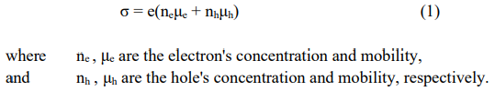
Temperature dependence of resistivity of a semiconductor:
FOUR PROBE EXPERIMENT
08
Intrinsic semi-conduction The process in which thermally or optically excited electrons contribute
to the conduction is called intrinsic semi-conduction. In the absence of photonic excitation, intrinsic semiconduction takes place at temperatures above 0 K as sufficient thermal agitation is required to transfer
electrons from the valence band to the conduction band. Conductivity for intrinsic semi-conduction. The
total electrical conductivity is the sum of the conductivities of the valence and conduction band carriers,
which are holes and electrons, respectively. It can be expressed as
Drift mobility determines the average drift velocity in the presence of an applied external field. It also
depends on the temperature. The mobility is a quantity that directly relates the drift velocity vd of charge
carriers to the applied electric field E across the material, i.e.
Notes:
Type of slide: Info-dense

Slide 9


FOUR PROBE EXPERIMENT
09
In the intrinsic region the number of electrons is equal to the number of holes, ne=nh=ni , so Equation (1)
implies that,
The electron density (electrons/volume) in the conduction band is obtained by integrating (density of
states x probability of occupancy of states) from the bottom to top of the conduction band. The detailed
calculations reveal that
Where N is a contant substituting 𝑛𝑖, in eq (3)
This shows that conductivity depends on temperature it decreases exponentially with decrease in
temperature.
Notes:
Type of slide: Info-dense

Slide 10


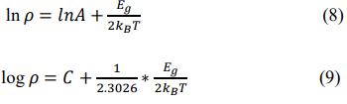

FOUR PROBE EXPERIMENT
10
Temperature dependence of resistivity:
Or,
Where A is a constant Taking Log
where C is a constant . Rewriting eq (9)

Slide 11

FOUR PROBE EXPERIMENT
11
Therefore, if a graph is plotted log 𝜌 vs (1000/𝑇) it should be a straight line and band gap Eg can be
determined from its slope as follows :

Slide 12
FOUR PROBE EXPERIMENT
12
P -Type Semiconductor | N -Type Semiconductor
In n-type semiconductor, pentavalent impurities are used for doping
The impurity is called donor impurity
In n-type semiconductor, the electrons act as a majority charge carriers
In n-type semiconductor, conductivity is mainly due to electrons, which are negatively charged.
In p-type semiconductor trivalent impurities are used for doping.
The impurity is called acceptor impurity
In p-type semiconductor, the holes act a as majority charge carriers.
In p-type semiconductor, conductivity is mainly due to holes, which are positively charged.
Notes:
Type of slide: Info-dense

Slide 13
FOUR PROBE EXPERIMENT
13
TECHNICAL SPECIFICATION
Instrument | Parameter | Range/Specification
Four Probe | Space between two probes | 2 mm
Sample crystal | Material and type | n-Germanium
Oven | Temperature range | RT to 200 °C
Heater resistance | 37 ohms
Heater voltage | 45 Volts
Measurement unit | Voltage range | 0-2 volt
Constant current generator | Current range | 0 20 mA
Resolution | 1 mA
Oven | Heating | 45V AC
Temperature sensor | LM35
Temperature range | 0 to 125 °C

Slide 14
FOUR PROBE EXPERIMENT
14
AIM
Determination of Resistivity and Band Gap of Semiconductors by Four Probe Method at different temperatures

Slide 15
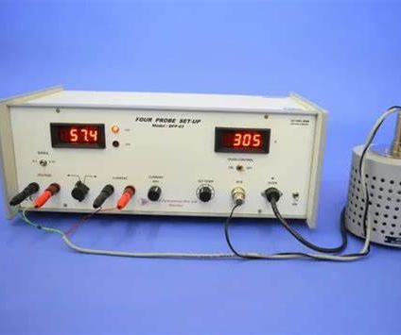
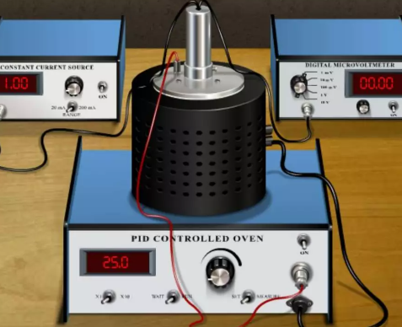
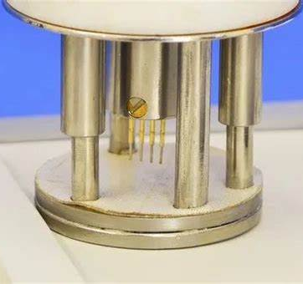
FOUR PROBE EXPERIMENT
15
Apparatus Required
01
02
03
Measurement unit
Oven arrangement
Four probe arrangement

Slide 16
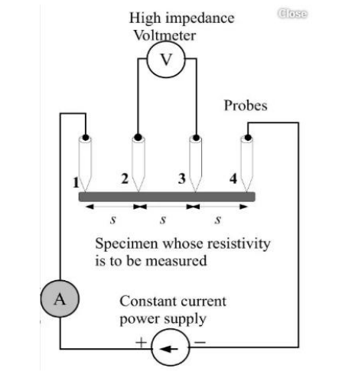
FOUR PROBE EXPERIMENT
16
CIRCUIT DIAGRAM
Circuit diagram for Determination of Resistivity and Band Gap of Semiconductors using Four Probe Method at different temperatures.

Slide 17
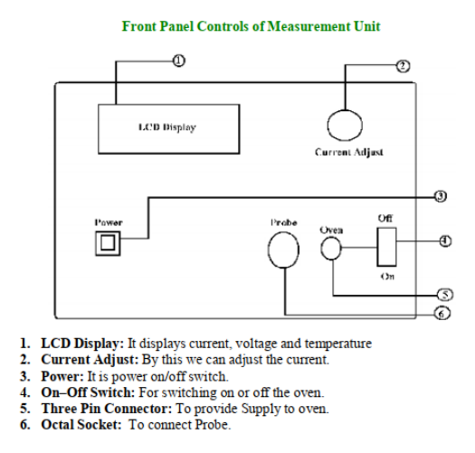
FOUR PROBE EXPERIMENT
17
Procedure
Take Measurement Unit of Band Gap and connect mains cord.
Sample crystal is attached with the probe arrangement. In case if it is not making proper contact with probes then adjust the horizontal screw provided on the four probe arrangement in the presence of Lab In-charge such that all four probe hold the crystal tightly. The Ge crystal is very brittle so handle it carefully.
Place the four probe arrangement in the oven.

Slide 18
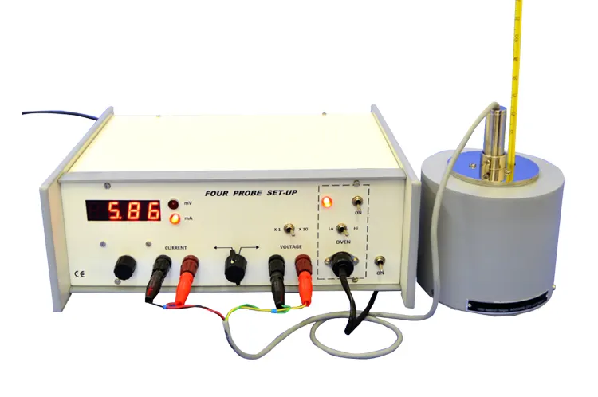
FOUR PROBE EXPERIMENT
18
Connect four probe (eight pin connector) to the given eight pin socket of measurement unit.
Connect the heater terminals (three pin socket) of the oven to the Measurement unit.
Set the controls of measurement unit as follows:
Oven toggle switch at ‘Off’ position.
Potentiometer at fully anticlockwise.

Slide 19
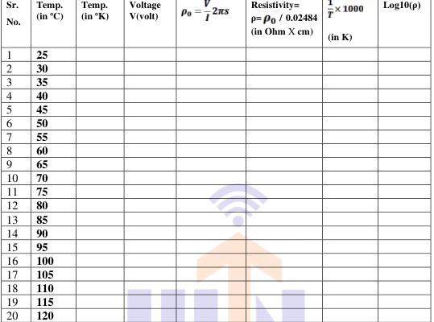
FOUR PROBE EXPERIMENT
19
OBSERVATION
Notes:
Type of slide: Info-dense

Slide 20
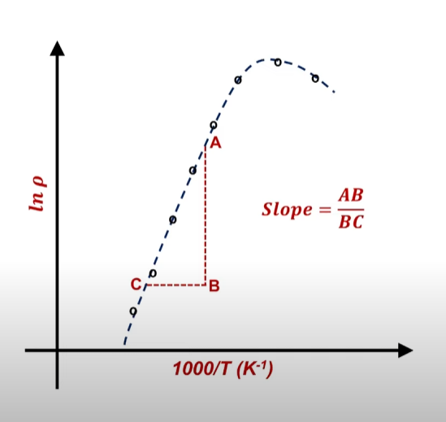
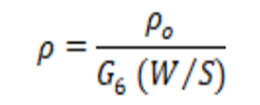
FOUR PROBE EXPERIMENT
20
CALCULATIONS
We are measuring resistivity on a thin slice-conducting bottom surface, we need to use function G6 as describe in theory. Now using following equation we can find the value of ρ.
V = voltage and I = Current S = Distance between probes = Given (s) = 2.0 mm
W = Thickness of the crystal = Given W=0.5mm. Hence, (W/S)=(0.5/2.0)=0.25
From Slope of the graph Log10(ρ) v/s 1000/T, Band Gap (Eg) can be calculated as,
Eg = 2 x 2.3026 x 1000 x K x slope
Calculation of Percentage error:
Percentage Error = Calculated value — Standard value x 100 Standard value

Slide 21
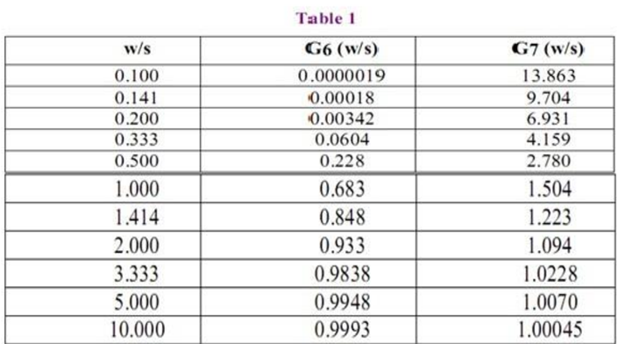
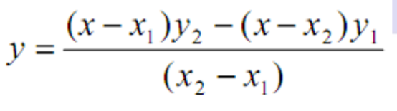
FOUR PROBE EXPERIMENT
21
Caluculations
To calculate Correction Factor = G6(0.25) we need to refer below table
To find the values in between the values supplied in the table, extrapolate the reading by the following formula
x = the value of w/s at which G6 or G7 is to be found
x1 = the value of w/s just less than x (from the table)
x2 = the value of w/s just greater than x (from the table)
y1 = the value of G6 or G7 at x1 (from the table)
y2 = the value of G6 or G7 at x2 (from the table)
y = The value of G6 is to be found for w/s = 0.25
Then from the table
Thus, the value of G6 (0.25) is 0.02484
Hence, now resistivity can be calculated
From Slope of the graph Log10() v/s 1000/T, Band Gap (Eg) can be calculated as,

Slide 22
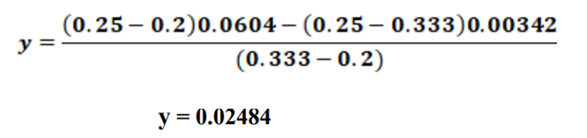
FOUR PROBE EXPERIMENT
22
Calculations
Where y = extrapolated value of G6 or G7 which is to be found
x = the value of w/s at which G6 or G7 is to be found
x1 = the value of w/s just less than x (from the table)
x2 = the value of w/s just greater than x (from the table)
y1 = the value of G6 or G7 at x1 (from the table)
y2 = the value of G6 or G7 at x2 (from the table)
y = The value of G6 is to be found for w/s = 0.25
Then from the table
Thus, the value of G6 (0.25) is 0.02484
Hence, now resistivity can be calculated
From Slope of the graph Log10(ρ) v/s 1000/T, Band Gap (Eg) can be calculated as,

Slide 23
FOUR PROBE EXPERIMENT
23
Calculations
Eg = 2 x 2.3026 x 1000 x K x slope
Where K is Boltzmann’s constant = 8.6 x 10-5 eV & Eg is Band Gap.
Standard Value of Eg for Ge is .66eV
Further, calculate the percentage error in calculation of Bang Gap.
Percentage Error=(Calculated Value−Standard Value)/(Standard Value)×100

Slide 24

FOUR PROBE EXPERIMENT
24
RESULTS
The resistivity of a given sample (n-type) Germanium is calculated at various temperature
successfully.
The Band Gap of (n-type) Germanium Semiconductors using Four Probe Method is
calculated and it is observed to be _________ and percentage error is ______________.

Slide 25
FOUR PROBE EXPERIMENT
25
Applications
Application 1: Semiconductor Wafer Characterization
Purpose: Measure silicon wafer properties for electronics.
Four-Probe Method: Measure resistivity by applying current and measuring voltage.
Quality Control: Ensure consistent resistivity for reliable electronic components.
Doping Analysis: Study dopant concentration and depth for customized devices.
Process Optimization: Fine-tune fabrication processes for improved performance.
Application 2: Thin-Film Solar Cells
Purpose: Enhance thin-film solar cell efficiency.
Four-Probe Method: Measure sheet resistance to ensure uniform layers.
Defect Detection: Identify and address conducting layer defects.
Oxide Optimization: Assess conductivity of transparent oxide layers.
Research & Development: Explore materials for better solar cell performance.

Slide 26
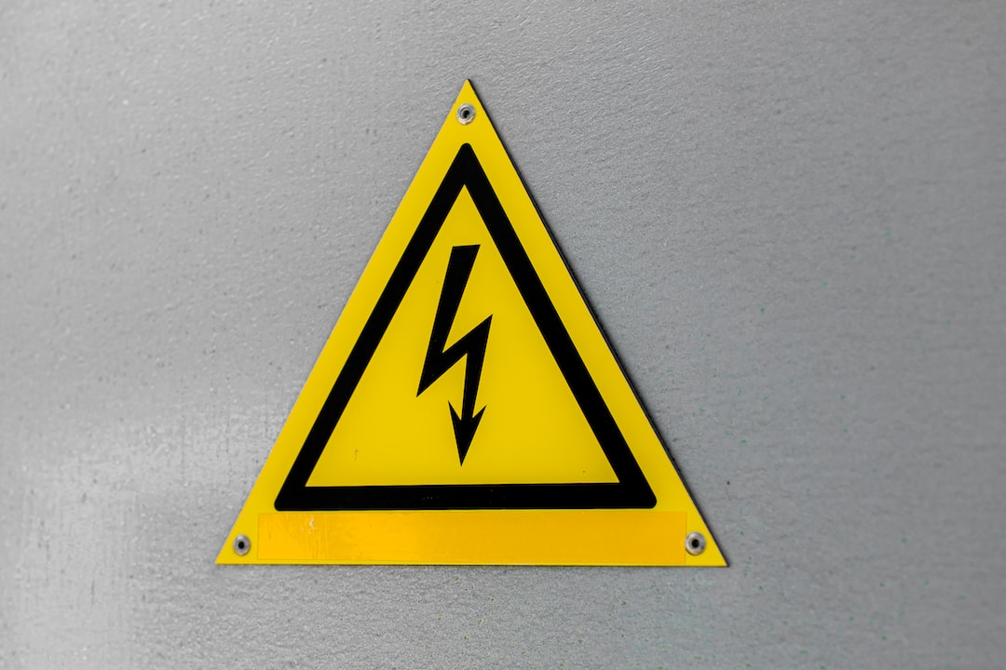
FOUR PROBE EXPERIMENT
26
PRECAUTIONS
Do not operate the instrument if suspect any damage to it.
To avoid electric shock, ensure that the instrument is properly grounded before making connection.
Make sure that the entire four probes hold the semiconductor crystal tightly otherwise it can be lost
Notes:
Type of slide: Info-dense

Slide 27


